Slide 1


R. GLENN HUBBARD
ANTHONY PATRICK O’BRIEN
FIFTH EDITION
© 2015 Pearson Education, Inc.

Slide 2
Pricing Strategy

Slide 3
Price, or prices?
Until now, we have assumed that firms charge a single price for their products.
In this chapter, we will consider when this is or is not an appropriate model for pricing.
We will ask:
When is it possible for a firm to charge different prices for the same product?
Why would a firm want to charge different prices?
Would such a practice increase or decrease efficiency?
What other pricing strategies make sense for firms to use?

Slide 4
Pricing Strategy, the Law of One Price, and Arbitrage
16.1
Define the law of one price and explain the role of arbitrage.

Slide 5
Arbitrage
Suppose that two identical products sold for different prices.
Example: An Apple iPad might sell for $499 in stores in Atlanta and for $429 in stores in San Francisco
What do you think would happen?
In all likelihood, some clever entrepreneur would start buying iPads in San Francisco, shipping them to Atlanta, and selling them for $499 (or a little less).
This practice of buying a product in one market and reselling it in a market with a higher price is known as arbitrage.

Slide 6
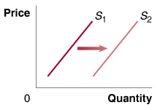
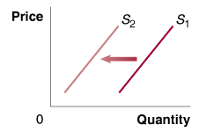
Arbitrage and the law of one price
If arbitrage in this manner can occur, what will happen to prices in Atlanta (where the price is currently $499) and San Francisco (where the price is currently $429)?
The supply of iPads in Atlanta will rise, decreasing the price in Atlanta.
The supply of iPads in San Francisco will fall, increasing the price in San Francisco.
If it were completely free to transport iPads from San Francisco to Atlanta, we would expect that the price would converge to being exactly the same in each location; this is the “law of one price”.

Slide 7
The law of one price, and transaction costs
Transporting the iPads from San Francisco to Atlanta is unlikely to be free, however. There are transaction costs that anyone who wanted to engage in this activity would incur.
Transaction costs: The costs in time and other resources that parties incur in the process of agreeing to and carrying out an exchange of goods or services.
We only expect the law of one price to hold perfectly when transaction costs are zero.
Naturally, the law of one price will only apply if resale of the product in question is possible.
Example: It is impossible to resell a haircut; so there is no expectation that haircuts will sell for the same price everywhere.

Slide 8
Why don’t all firms charge the same price?
It often seems as if different firms are charging different prices for the same product, even when people could easily choose between them.
Example: The same blu-ray disc may sell for different prices on different web sites.
But is the same movie on different web sites really the same product? Consider the table below:
Product: The Amazing Spider-Man 2 Blu-ray Disc
Company | Price
Amazon.com | $24.99
Walmart.com | 24.98
WaitForeverForYourOrder.com | 22.50
JustStartedinBusinessLastWednesday.com | 21.25
Table 16.1
Which internet retailer would you buy from?

Slide 9
Some people will pay the higher price
Some people might be willing to take a risk on the last site, in order to save a couple of dollars.
But many would buy from Amazon.com or Walmart.com instead; here the “product” might refer not only to the physical disc, but trusting the company to deliver it on time, not to do anything fraudulent with your credit card information, etc.
Product: The Amazing Spider-Man 2 Blu-ray Disc
Company | Price
Amazon.com | $24.99
Walmart.com | 24.98
WaitForeverForYourOrder.com | 22.50
JustStartedinBusinessLastWednesday.com | 21.25
Table 16.1
Which internet retailer would you buy from?

Slide 10
Price Discrimination: Charging Different Prices for the Same Product
16.2
Explain how a firm can increase its profits through price discrimination.

Slide 11
Movie ticket pricing
Suppose you go with your extended family to see a movie:
As a student, you will probably get a “student discount”.
Your younger sibling might get a “child discount”, or even get in free if they are young enough.
Your grandparents might get a discount of their own.
Your parents will probably have to pay “full price”.
The movie theater will charge these different prices, even though it costs them the exact same amount to show the movie to each one of you.
This is an example of price discrimination: the practice of charging different prices to different customers for the same product when the price differences are not due to differences in cost.

Slide 12
Discrimination? Isn’t that illegal?
Discrimination on the basis of arbitrary characteristic, such as race or gender, is certainly illegal.
Price discrimination is performed, however, on the basis of willingness and ability to pay; and as such is generally legal.
Example: Students and the elderly tend to be poorer than adults of working age, so their willingness to pay for a movie ticket tends to be lower.
There are some gray areas. Car insurance companies typically charge lower prices to women than to men, because men have more accidents than women.
But what if a car company determined that one race tended to have more accidents than another?

Slide 13
When is price discrimination possible?
Price discrimination is possible when:
Firms possess market power
Otherwise, the firm is a price-taker.
Identifiable groups of consumers have different willingness to pay for the product
If the firm cannot identify different groups, it cannot expect to charge those groups different prices.
Arbitrage of the product is not possible
Either because reselling the product is not logically possible (an education, for example) or because the transaction costs involved make resale impractical.

Slide 14
Military discounts at the Home Depot
Home Depot is a home and garden supply store. It offers a 10% discount to active and retired military personnel, reservists, and to their families.
Home Depot certainly has some market power, and can identify military personnel using their military identification cards.
But doesn’t arbitrage seem possible?
Some possible reasons why this program doesn’t get abused:
A 10% discount is relatively small.
Many military personnel would consider it “dishonorable” to abuse the discount privilege.
Transaction costs (the inconvenience of having someone else buy goods for you) are high.
Can you think of others?

Slide 15
Groups of consumers with different willingness to pay
If firms can practice price discrimination, who will they charge a higher price to?
Groups with a higher demand
These people are willing to pay more, and firms will profit by charging them more.
Groups with a lower price elasticity of demand
These people are less sensitive to price; raising the price on them will result in fewer of them ceasing to use the product.

Slide 16
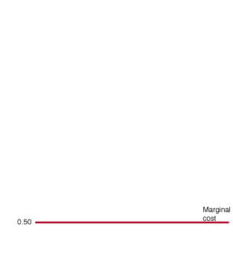
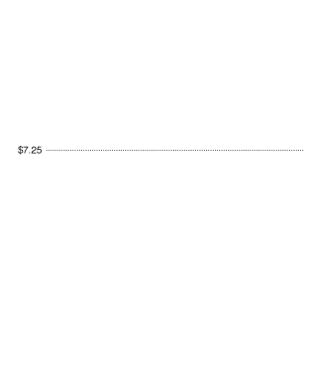
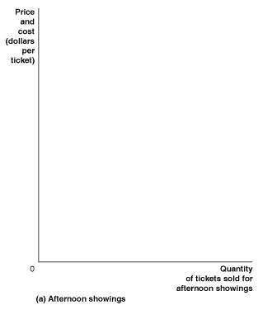
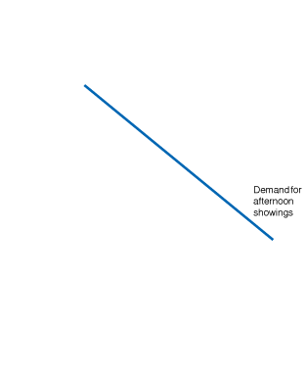
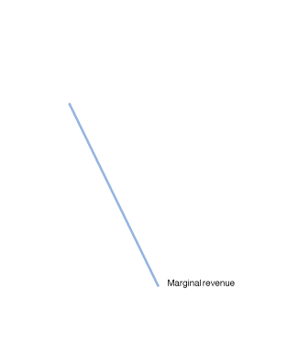
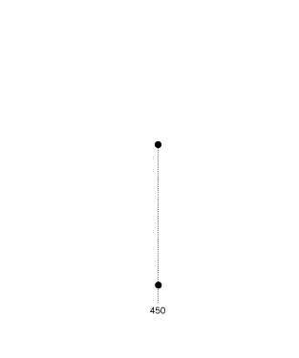
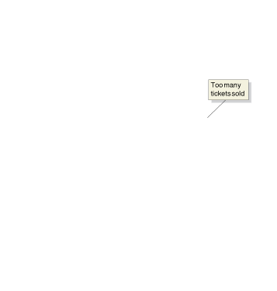
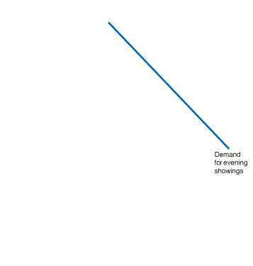
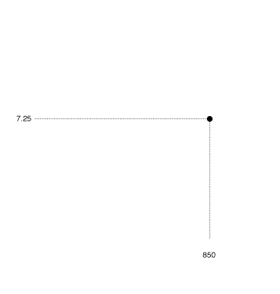
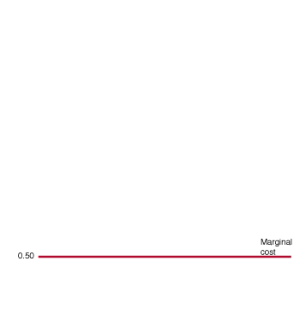
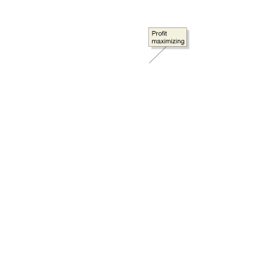
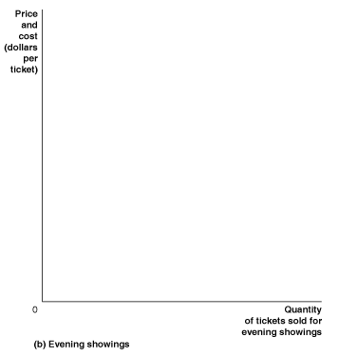
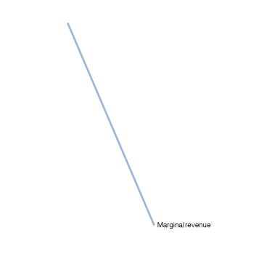
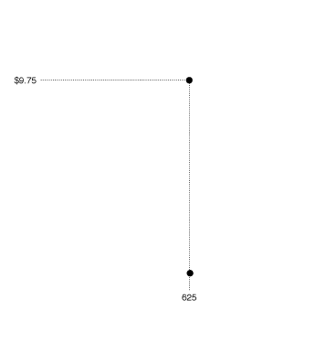
Price discrimination by a movie theater
Figure 16.1
Price discrimination by a movie theater
Fewer people want to go to the movies in the afternoon than in the evening.
In the afternoon, the profit-maximizing price for a ticket to an afternoon showing is $7.25, using MC = MR.
When demand is higher in the evening, the profit-maximizing price is higher.
Notes:
Fewer people want to go to the movies in the afternoon than in the evening. In
panel (a), the profit-maximizing price for a ticket to an afternoon showing is $7.25.
Charging this same price for evening showings would not be profit maximizing, as
panel (b) shows. At a price of $7.25, the theater would sell 850 tickets to evening
showings, which is more than the profit-maximizing number of 625 tickets. To
maximize profit, the theater should charge $9.75 for tickets to evening showings.

Slide 17
Yield management
Yield management is the practice of rapidly adjusting prices of a fixed, perishable good in order to maximize profit.
Example: Airlines adjust prices of flights depending on how full the flight is, and what they anticipate demand for the flight will be before departure.
Yield management is a sophisticated form of price discrimination that relies on gathering and understanding data about your customers and their behavior.

Slide 18
Airlines: the kings of price discrimination
Airlines divide their customers into two main categories: business travelers and leisure travelers.
Business travelers are generally less sensitive to price, so profit-maximization suggests charging them more.
But no-one would volunteer the information that they were a business traveler, if it meant they would pay more.
Instead, airlines seek to infer this information, from:
How far in advance you are booking the ticket, and
How long you will stay.

Slide 19
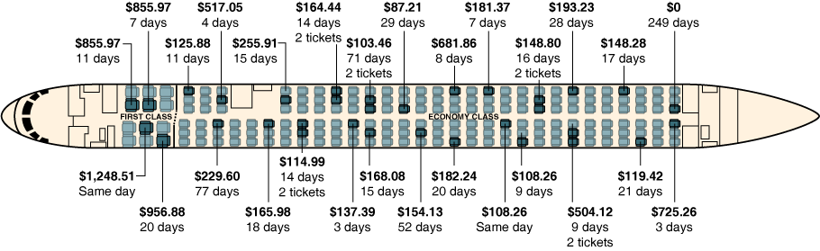
Price discrimination on a United flight
The figure below illustrates price discrimination on a United Air Lines flight from Chicago to Los Angeles.
Notice that people who bought tickets more than 14 days in advance generally paid lower prices.
But there are some exceptions, suggesting yield management by the airline.
Figure 16.2
33 customers and 27 different prices
Notes:
To fill as many seats on a flight as possible, airlines charge many different ticket
prices. The 33 passengers on this United Air Lines flight from Chicago to Los Angeles
paid 27 different prices for their tickets, including one passenger who used
frequent flyer miles to obtain a free ticket. The first number in the figure is the
price paid for the ticket; the second number is the number of days in advance that
the customer purchased the ticket.
Source: “So, How Much Did You Pay for Your Ticket,” by Matthew L. Wald. The New
York Times, April 12, 1998. Copyright © 1998 by The New York Times Company. All
rights reserved. Used by permission and protected by the copyright laws of the United
States. The printing, copying, redistribution, or retransmission of the Material without
express written permission is prohibited.

Slide 20
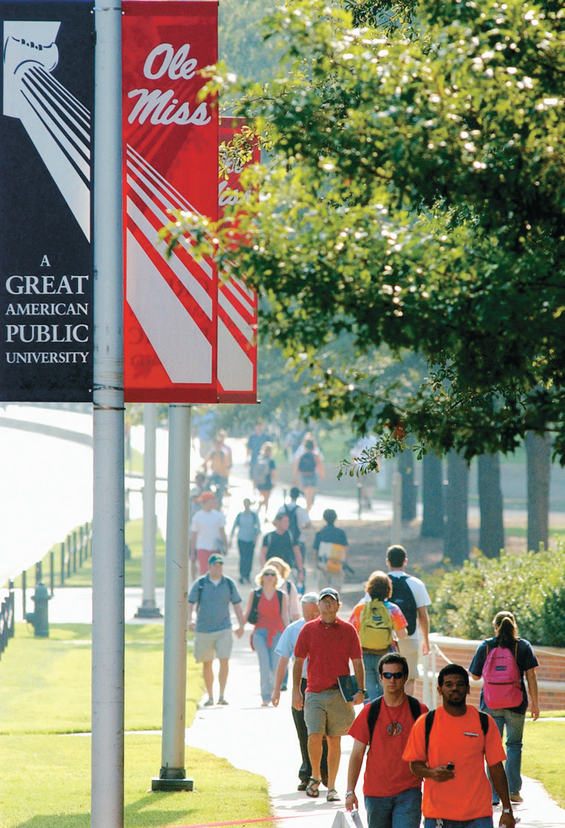
How colleges use yield management
Traditionally, colleges based financial aid decisions only on the incomes of prospective students.
In recent years, however, many colleges have started using yield management techniques, first developed for the airlines, to determine the amount of financial aid they offer different students.
This means students who seem more sensitive to price are given more generous financial aid packages.

Slide 21
How do the colleges do this?
How can a college tell who is more or less sensitive to price?
Your intended major
Did you come for an on-campus interview?
Your home state
Your family income
Whether you applied for “early decision”
Do you think this is a fair practice for colleges to use?

Slide 22
Perfect price discrimination
Perfect or first-degree price discrimination refers to charging every consumer a price exactly equal to their willingness to pay for a product.
In this case, every consumer would buy the product, but consumer surplus would be zero: the firm would extract all surplus from the market.
Perfect price discrimination is probably impossible in practice; but it can illustrate a surprising result: price discrimination might increase economic efficiency.

Slide 23
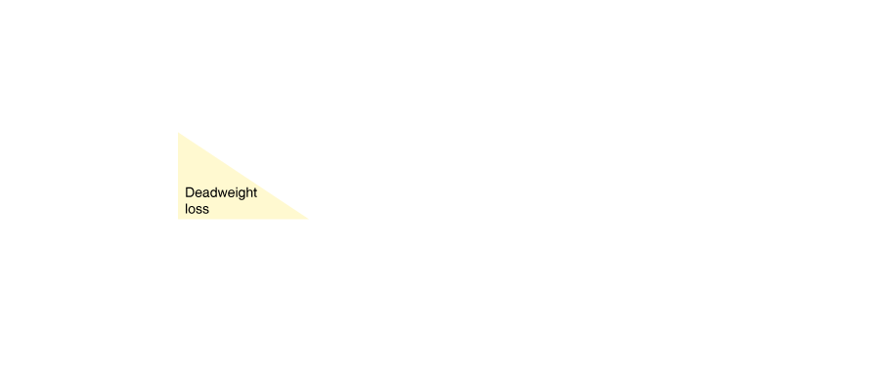


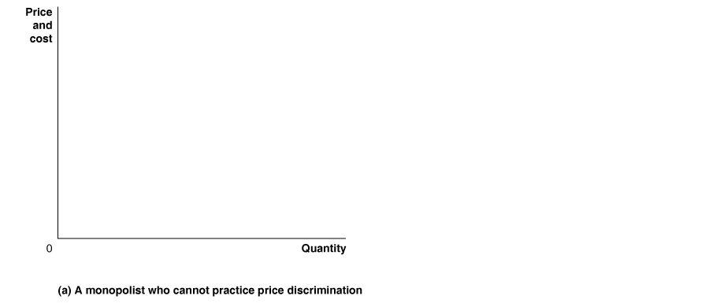
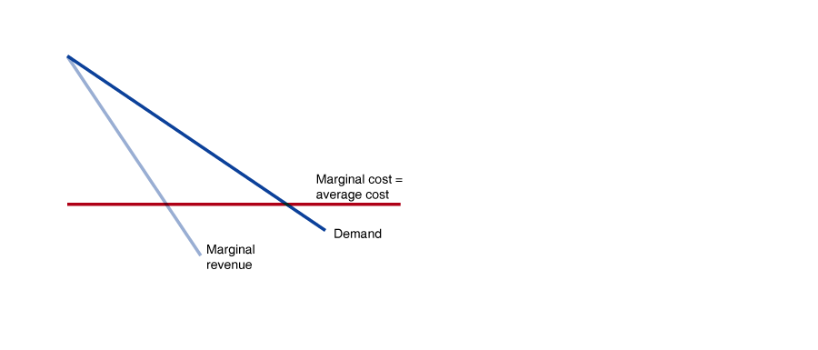
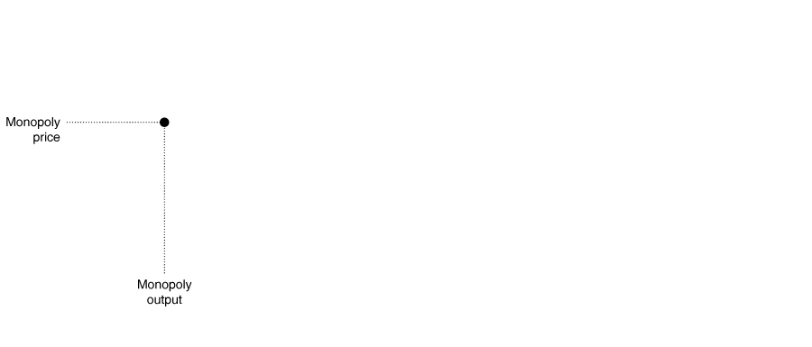

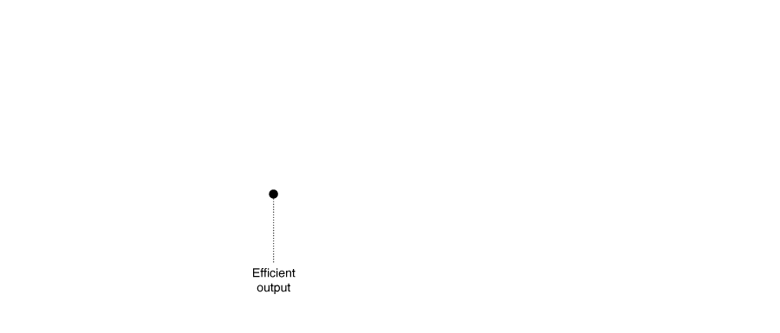
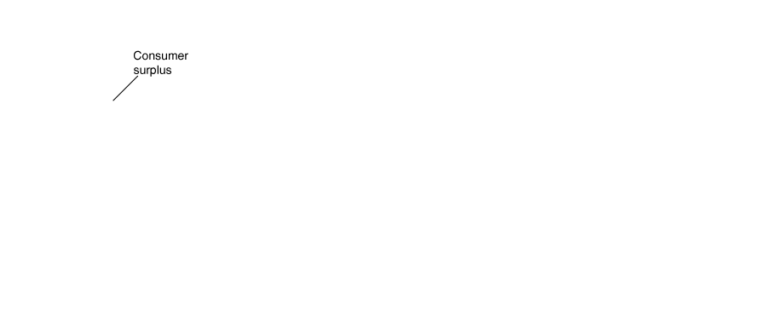
Comparing monopoly with no price discrimination…
In this panel, the monopolist cannot perform price discrimination.
For simplicity, we assume that the marginal cost of production is constant.
As usual, the monopolist charges the price where marginal cost equals marginal revenue.
Figure 16.3a
Perfect price discrimination
At this price, many consumers who would be willing to pay more than the marginal cost of the product miss out.
This results in deadweight loss.
Notes:
Panel (a) shows the case of a monopolist who cannot practice price discrimination
and, therefore, can charge only a single price for its product. The graph shows that
to maximize profit, the monopolist will produce the level of output where marginal
revenue equals marginal cost. The resulting profit is shown by the area of
the green rectangle. Given the monopoly price, the amount of consumer surplus
in this market is shown by the area of the blue triangle. The economically efficient
level of output occurs where price equals marginal cost. Because the monopolist
stops production at a level of output where price is above marginal cost, there is a
deadweight loss equal to the area of the yellow triangle. In panel (b), the monopolist
is able to practice perfect price discrimination by charging a different price to
each consumer. The result is to convert both the consumer surplus and the deadweight
loss from panel (a) into profit.

Slide 24
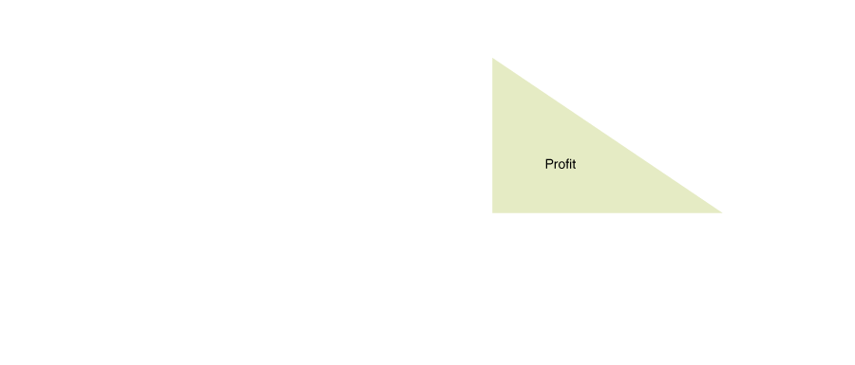
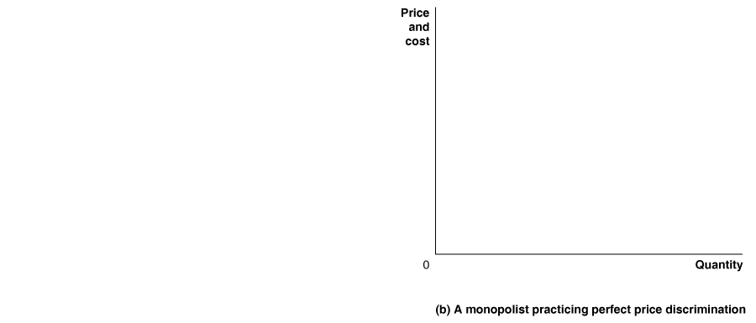
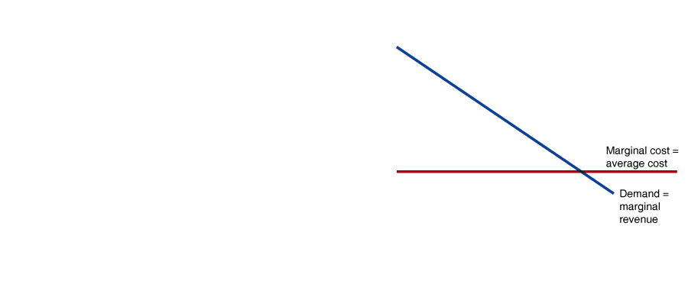
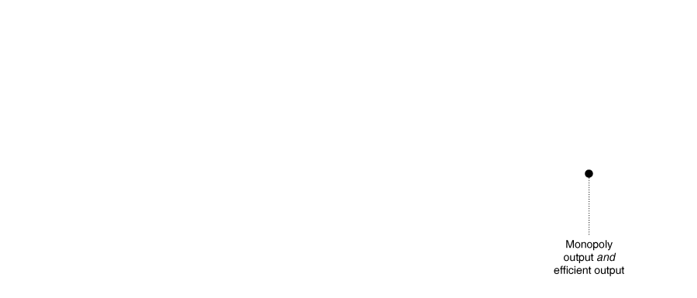
…and with perfect price discrimination
Figure 16.3a&b
Perfect price discrimination
Let’s allow the monopolist to perfectly price discriminate.
It sells to every consumer with a willingness to pay greater than the marginal cost; this maximizes profit.
Then the monopolist will sell the efficient quantity!

Slide 25
Results of price discrimination
We know that price discrimination increases profits for firms (or else, they wouldn’t do it).
But it also decreases consumer surplus.
Overall, can we say that price discrimination increases economic efficiency (i.e. decreases deadweight loss)?
Unfortunately, not always; the results of price discrimination on overall welfare are ambiguous.

Slide 26
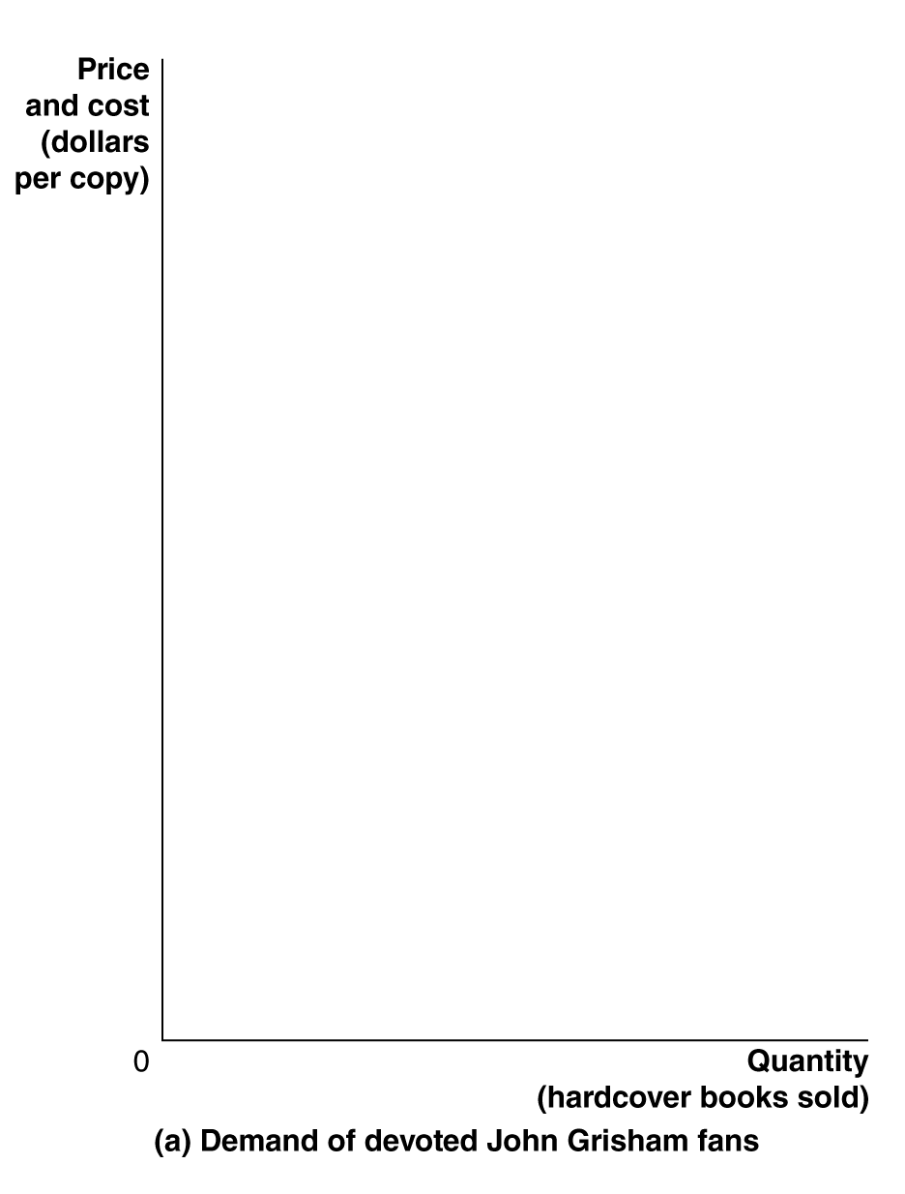
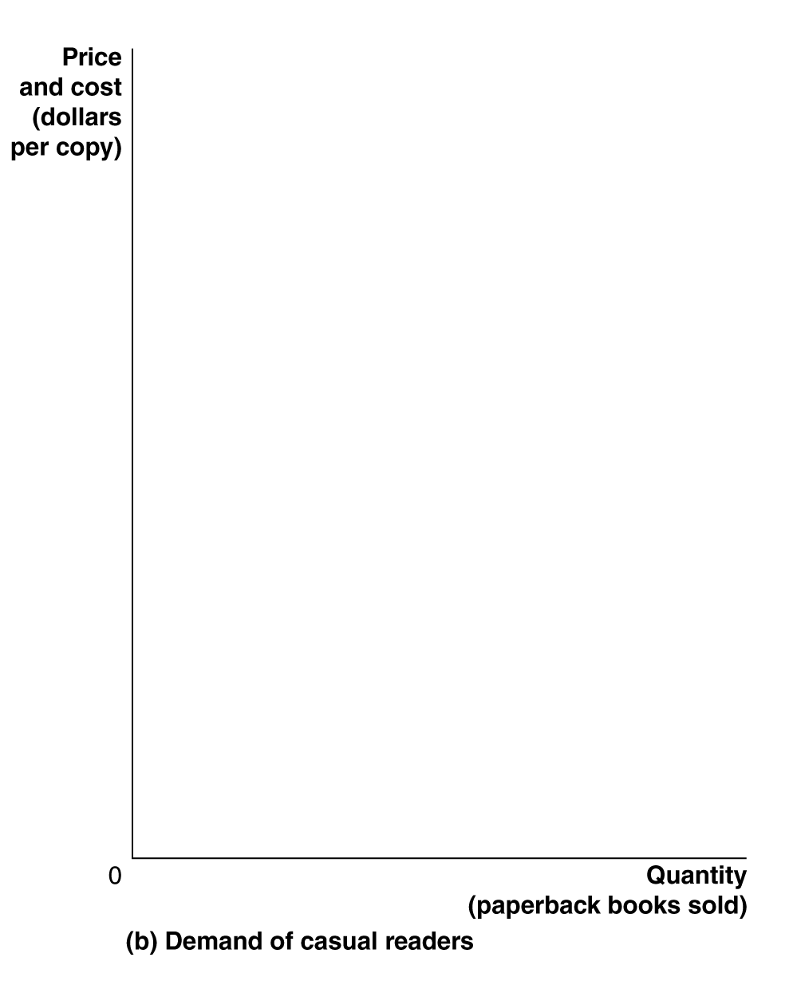
Price discrimination across time
A less obvious way in which firms price discriminate is across time.
For example, book publishers often sell a hardcover version, and some months later, release a much cheaper, paperback version.
Figure 16.4
Price discrimination across time
Notes:
Publishers issue most novels in hardcover editions at high prices to satisfy the demand
of the novelists’ most devoted fans. Later, publishers issue paperback editions
at much lower prices to capture sales from casual readers. In panel (a), with a marginal
cost of $1.50 per copy for a hardcover edition, the profit-maximizing
level of
output is 500,000 copies, which can be sold at a price of $28.95. In panel (b), the
more elastic demand of casual readers and the slightly lower marginal cost result
in a profit-maximizing output of 1,000,000 for the paperback edition, which can
be sold at a price of $9.99.

Slide 27
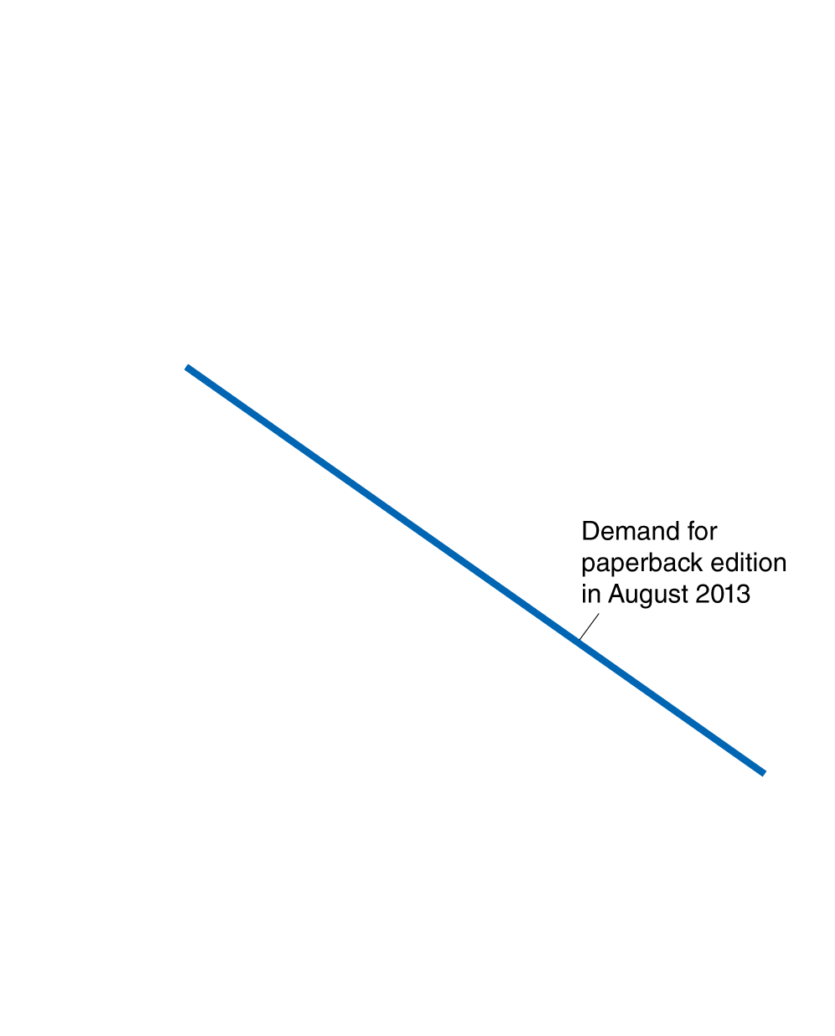
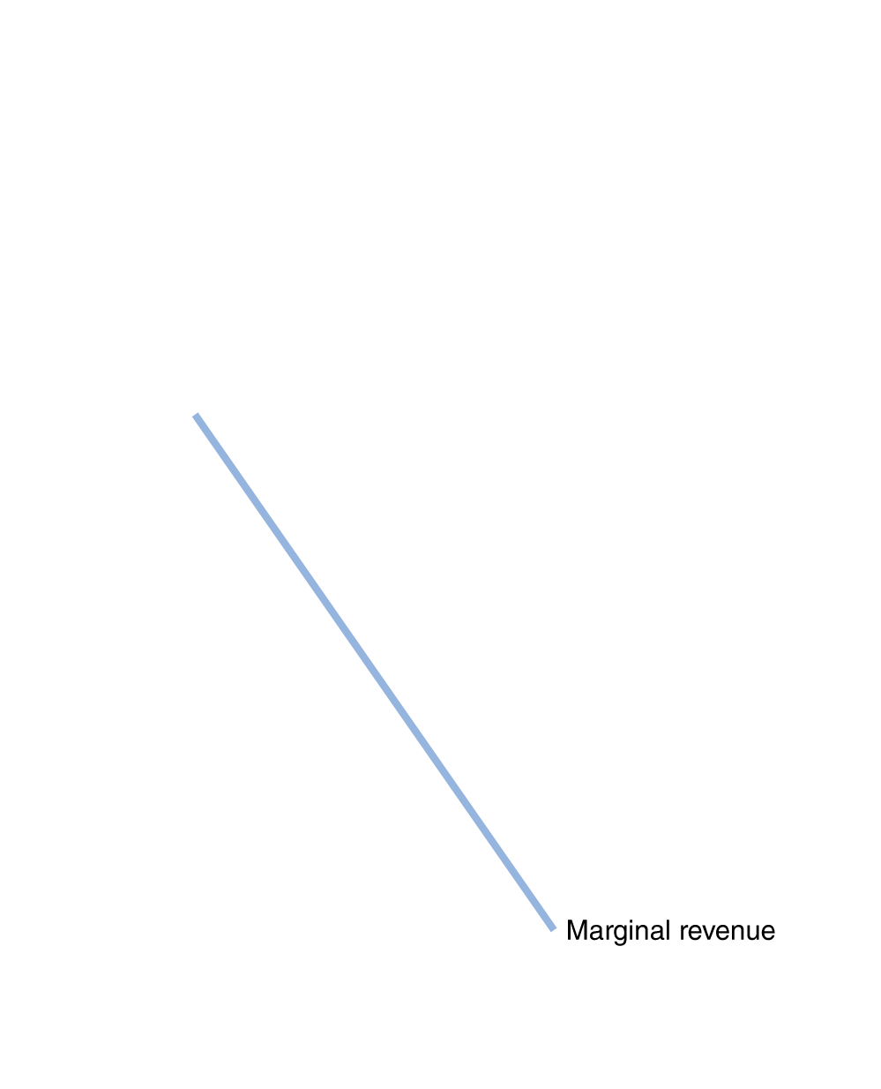
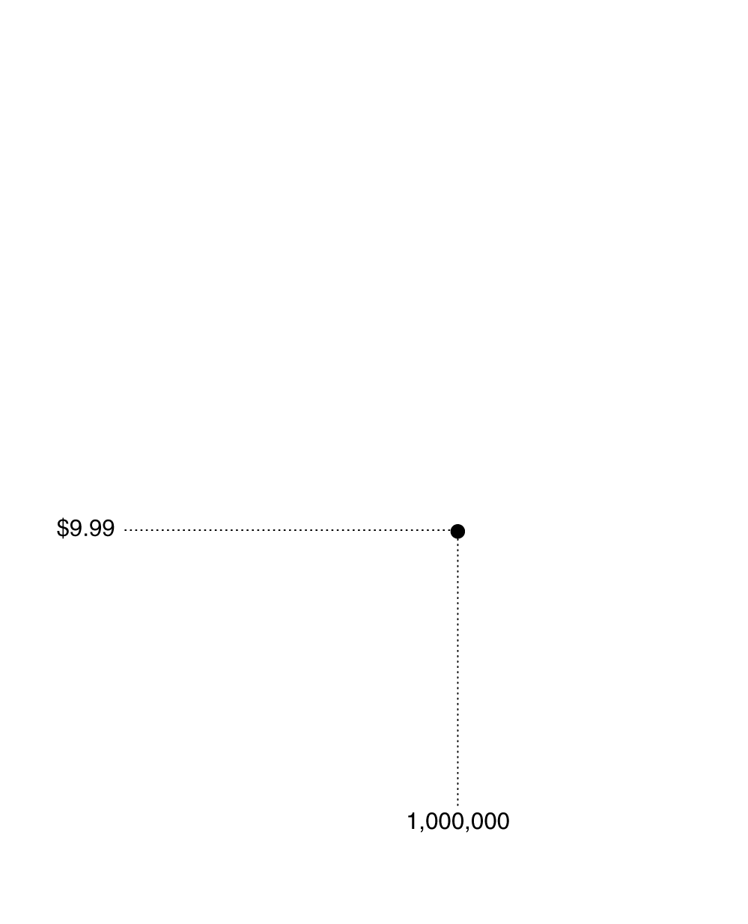
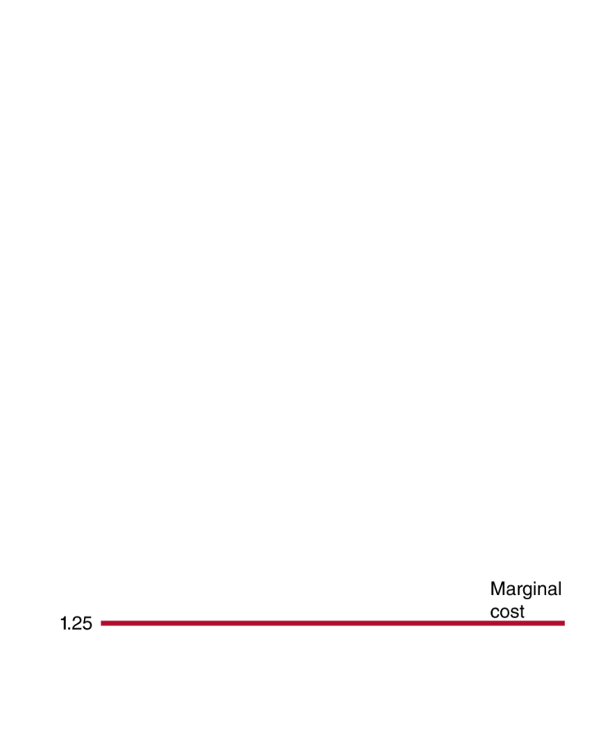
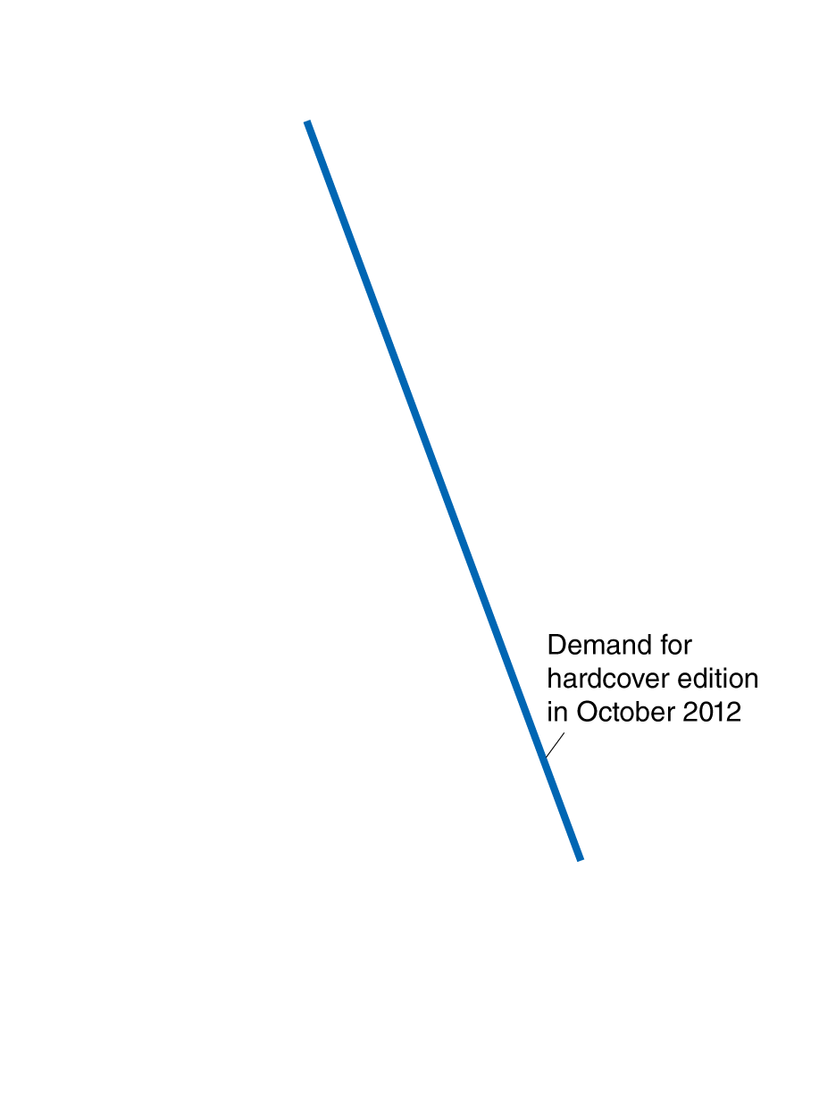
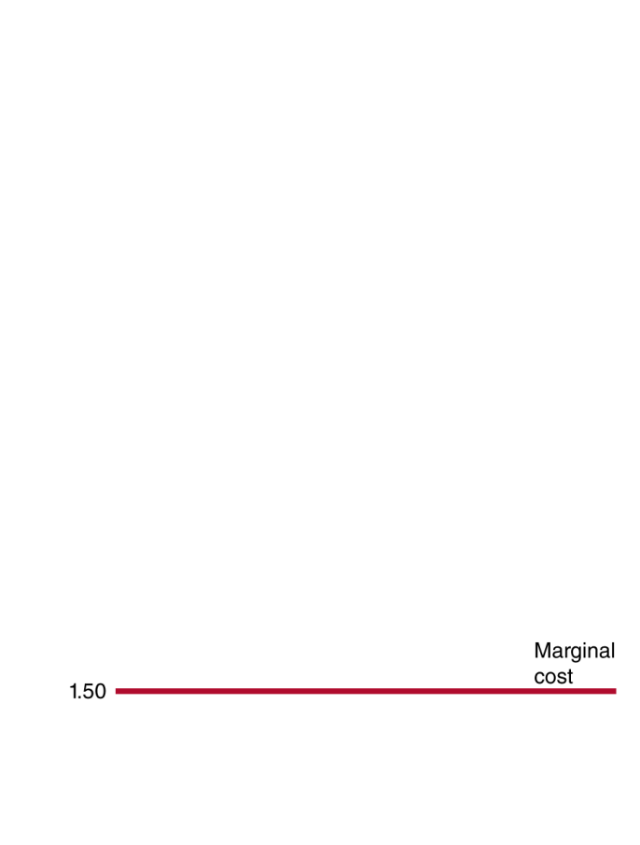
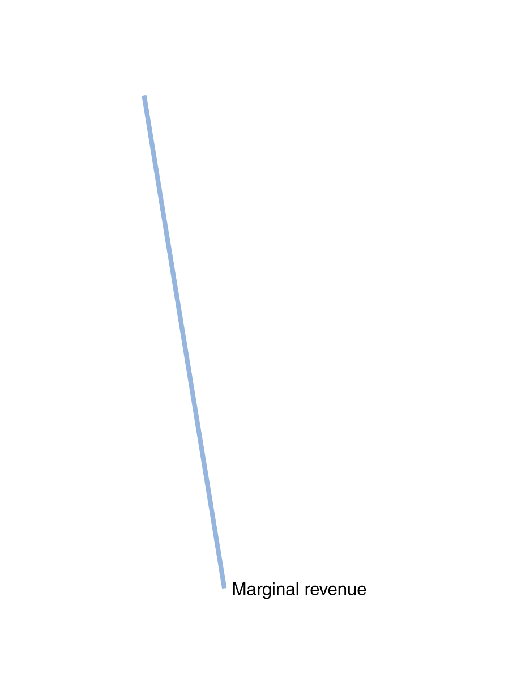
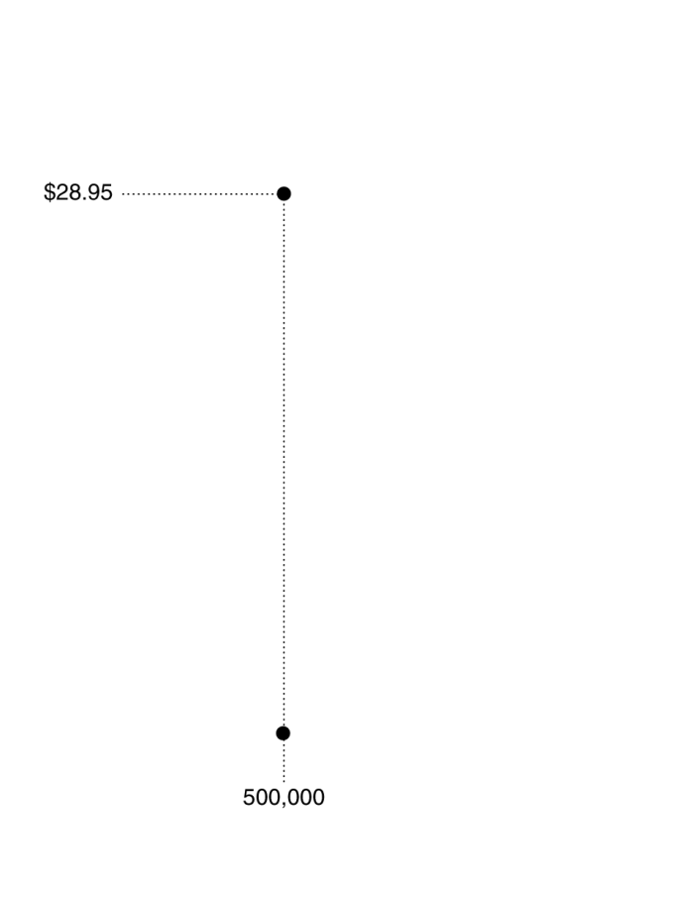
Why discriminate across time?
The reason for the price difference is not the difference in cost; this cost difference is trivial.
The publisher simply wants to determine who is a huge fan and can’t wait to read the book, and hence is willing to pay more; these people will get charged more.
Figure 16.4
Price discrimination across time

Slide 28
Returning to the legality of price discrimination
In 1936, Congress passed the Robinson-Patman Act, an antitrust law that:
outlawed price discrimination that reduced competition
contained language that could be interpreted as making illegal all price discrimination
In the 1960s, the Federal Trade Commission tested the scope of this law, suing Borden Inc. for selling evaporated milk under its own brand, and under a store brand, for two different prices.
The courts ruled that such price discrimination increased rather than reduced competition, and have generally followed this pattern in subsequent years.

Slide 29
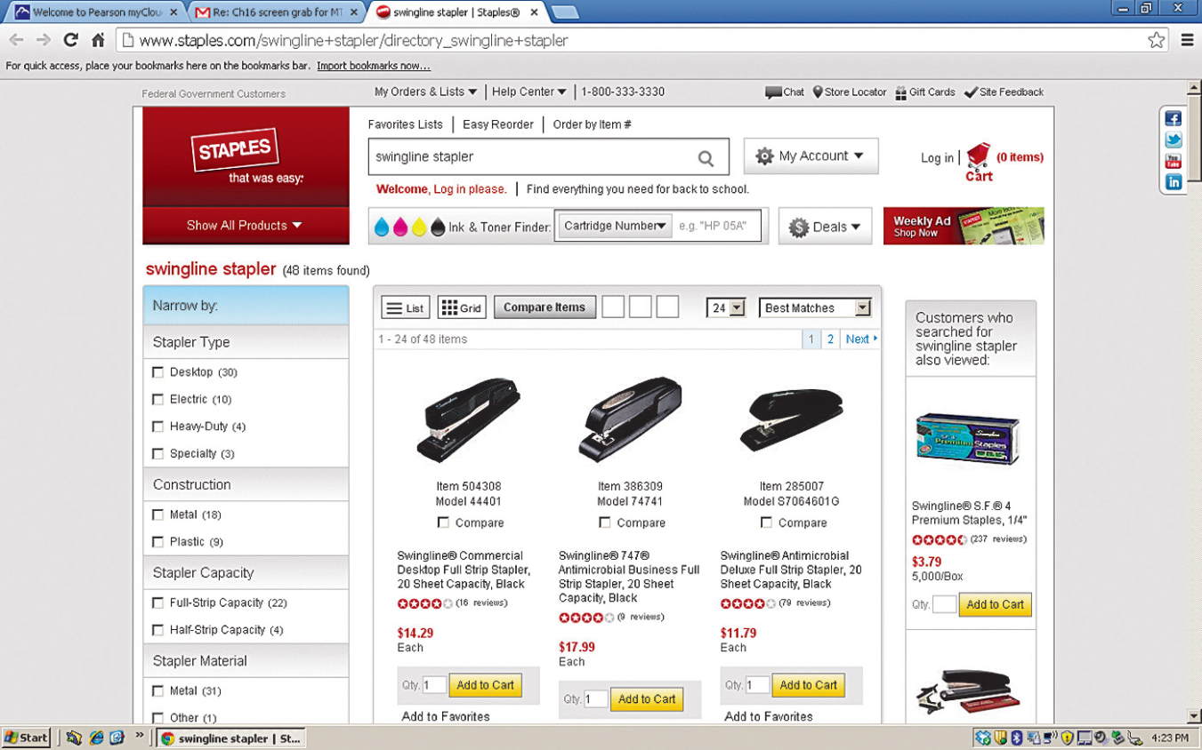
The internet and price discrimination
When you shop for a product online, the Web site may have various information about you:
Your location
Your browsing history
Maybe even personal facts about you, like age, gender, and income.
WSJ reporters found the same Swingline stapler at Staples.com depended on proximity to rival stores like OfficeMax and Office Depot:
Customers within 20 miles of a rival store saw a price of $14.29, while customers further away saw a price of $15.79.

Slide 30
Other Pricing Strategies
16.3
Explain how some firms increase their profits through the use of odd pricing, cost-plus pricing, and two-part tariffs.

Slide 31
Odd pricing
Many firms use odd pricing: charging $4.95 instead of $5.00, or $199 instead of $200. Why?
The strongest reason for the continuation of odd pricing is the apparent psychological effect that it has on consumers.
Researchers have tested this by estimating demand curves for items statistically, then surveying people to find out how much they would buy if the price were, say, $9.99 instead of $10.00
This price difference should result in a very small increase in quantity demanded.
But the actual increase in quantity demanded is generally much larger than expected.

Slide 32
Cost-plus pricing
Many firms use cost-plus pricing: pricing an item equal to some fixed percentage above average total cost.
In theory, this approach is incorrect: profit maximization requires pricing where MC = MR.
In practice, cost-plus pricing comes close to achieving profit-maximization in two situations:
When marginal cost and average cost are roughly equal
When a firm has difficulty estimating its demand curve
Particularly in the latter case, cost-plus pricing can be useful if the firm can identify which products are likely to have more or less price-elastic demand, and adjust the markup accordingly.

Slide 33
Cost-plus pricing in the publishing industry
Cost-plus pricing is common in the publishing industry, where it is often difficult to assign costs (labor, etc) to particular books.
A common approach is to multiply the physical cost of production by 7 or 8 to arrive at the final price of the book.
The costs on the right are for a book expected to sell 5000 copies; average cost per book is $4.50.
Plant Costs
 | Typesetting | $3,500
 | Other plant costs | 2,000
Manufacturing Costs
 | Printing | $5,750
 | Paper | 6,250
 | Binding | 5,000
Total Production Cost
$22,500
7 times this gives $31.50; the book would likely sell for around this price. The publisher would receive about 60% of this, and the amount above the average cost would be used to pay for salaries, marketing, royalties, warehousing… and profit.

Slide 34
Two-part tariffs
Another pricing strategy that a firm can use is a two-part tariff: making consumers pay one price (or tariff) for the right to buy as much of a related good as they want at a second price.
Memberships, at Sam’s Club, your local tennis club, or the local video store, often work this way.
Phone companies also use this approach, with a monthly charge plus a fee for additional minutes.
Why would companies use such a pricing strategy?
We will investigate by considering Disney World’s pricing structure for rides.

Slide 35
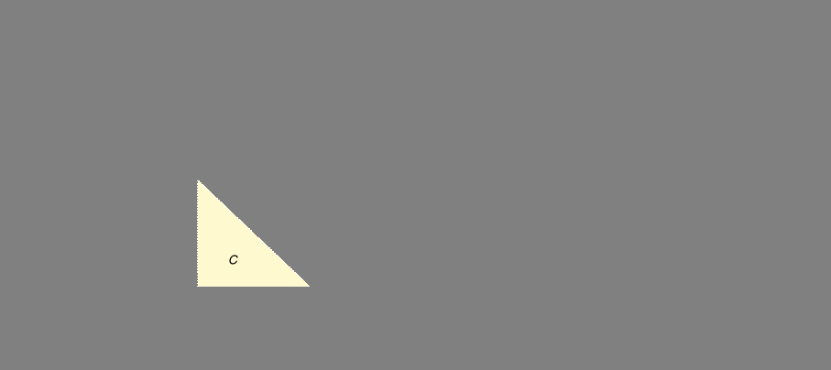
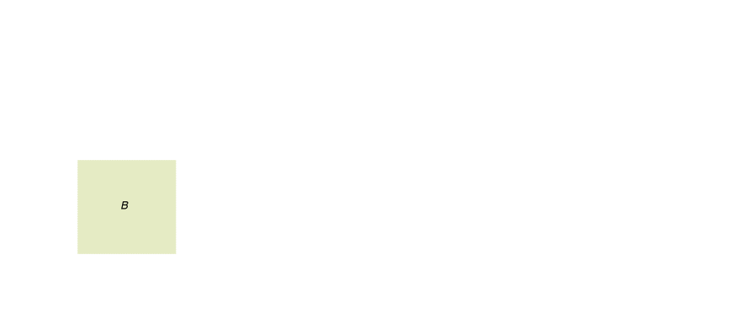

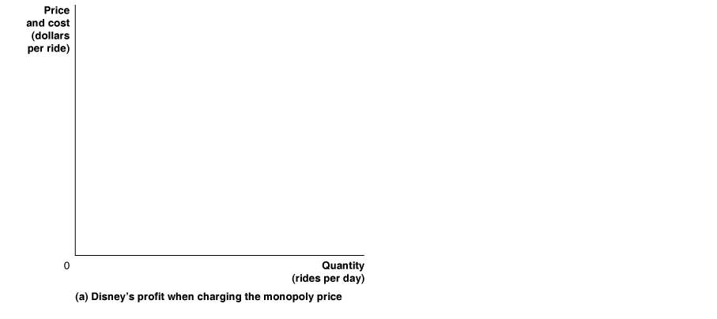
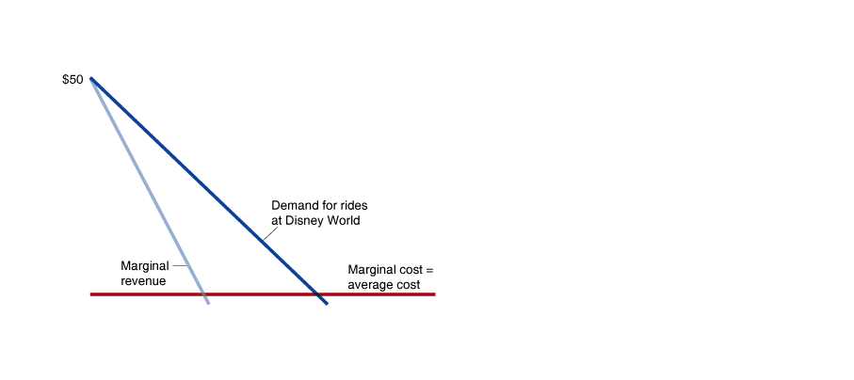
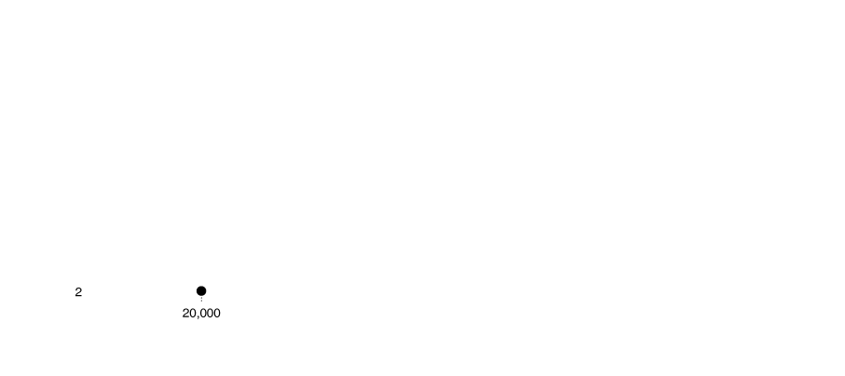
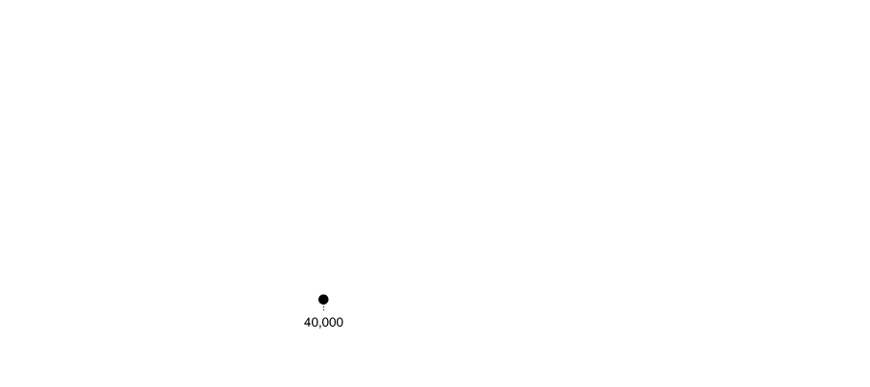
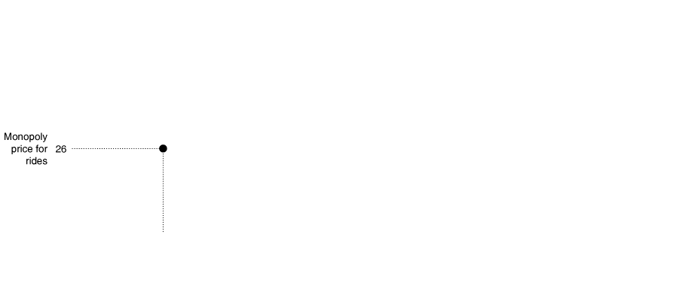
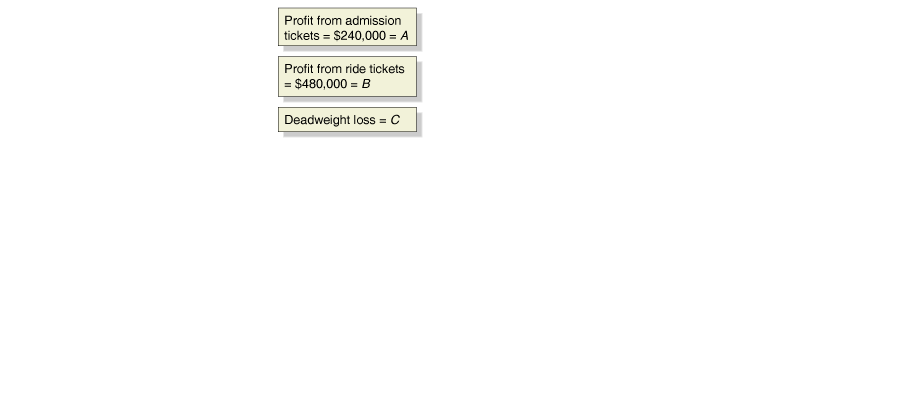
Disney’s pricing decision
Suppose Disney World has just one ride, with demand as shown.
The marginal cost of a ride is very small: $2.
If Disney charges the monopoly price, it sells 20,000 rides, making profit B.
Figure 16.5a
A two-part tariff at Disney World
Assuming Disney can identify its customers’ willingness to pay for tickets, it also makes profit from selling admission tickets: area A.
Area C is deadweight loss.
Notes:
In panel (a), Disney charges the monopoly price of $26 per ride ticket and sells
20,000 ride tickets. Its profit from ride tickets is shown by the area of rectangle B,
or $480,000. If Disney is in the position of knowing every consumer’s willingness
to pay, it can also charge a price for admission tickets that would result in the total
amount paid for admission tickets being equal to total consumer surplus from the
rides. Total consumer surplus from the rides equals the area of the triangle,
A,
or $240,000. So, when charging the monopoly price, Disney’s total profit equals
$480,000 + $240,000 or $720,000. In panel (b), Disney charges the perfectly competitive
price of $2, which results in a quantity of 40,000 ride tickets sold. At the
lower ride ticket price, Disney can charge a higher price for admission tickets,
which will increase its total profits from operating the park to the area of the green
triangle, or $960,000.

Slide 36

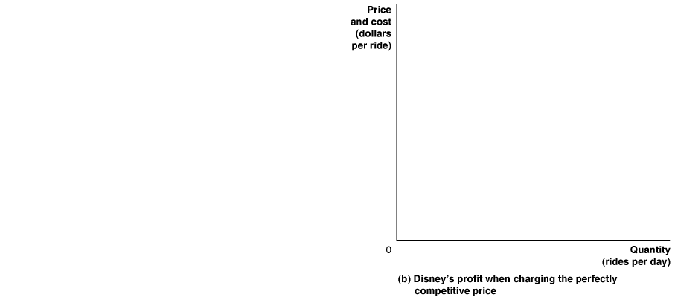
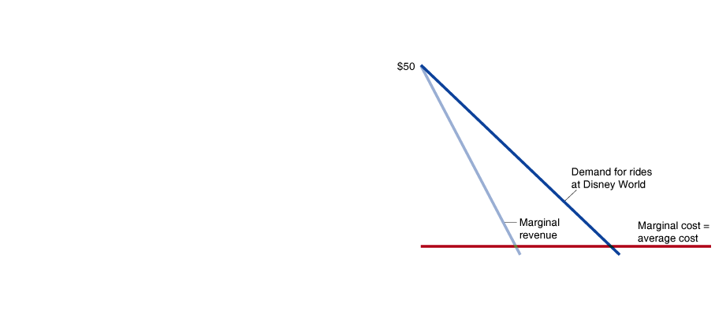
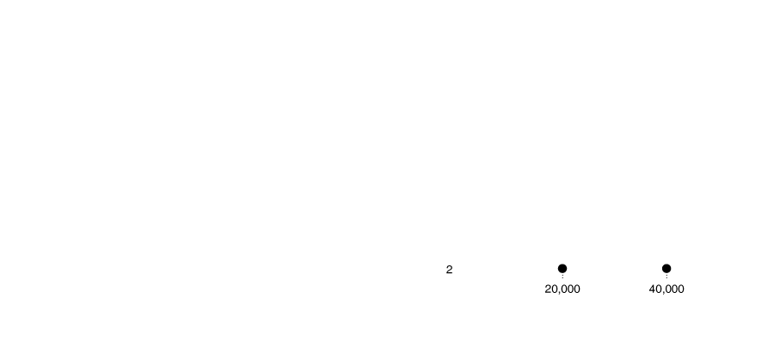

Near perfect price discrimination at Disney
If Disney instead charged admission equal to the willingness to pay for each rider, it obtains the whole surplus as its profit.
Everyone willing to pay at least the marginal cost of a ride gets to go to the park: economic efficiency.
This argument relies on Disney’s ability to price discriminate among park entrants.
Figure 16.5b
A two-part tariff at Disney World
The vast number of pricing options Disney provides suggests that this is indeed how Disney tries to make its profit.

Slide 37
Disney’s profits from different pricing strategies
By charging a low price for rides, our hypothetical Disney park makes more money than charging a high price, since it recoups the money in admission tickets.
 | Monopoly Price for Rides | Competitive Price for Rides
Profits from admission tickets | $240,000 | $960,000
Profits from ride tickets | 480,000 | 0
Total profit | 720,000 | 960,000
Table 16.2
Disney’s profits per day from different pricing strategies
In practice, Disney does not even charge the marginal cost for its rides, since it is so small that it is not worth collecting.
Disney’s actual profits are smaller than what this would suggest, because it cannot perfectly price discriminate.

Slide 38
Common misconceptions to avoid
The law of one price will only hold if transaction costs are trivial.
Discrimination and price discrimination are two different concepts. Don’t confuse the two.
While price discrimination reduces consumer surplus, it may actually increase economic efficiency, and hence may often be good for society.

